Slide 1

Information Retrieval Course
Wikipedia Search Engine
Presenters: Itay Saig & Beni Ifland
Winter 2022-23

Slide 2
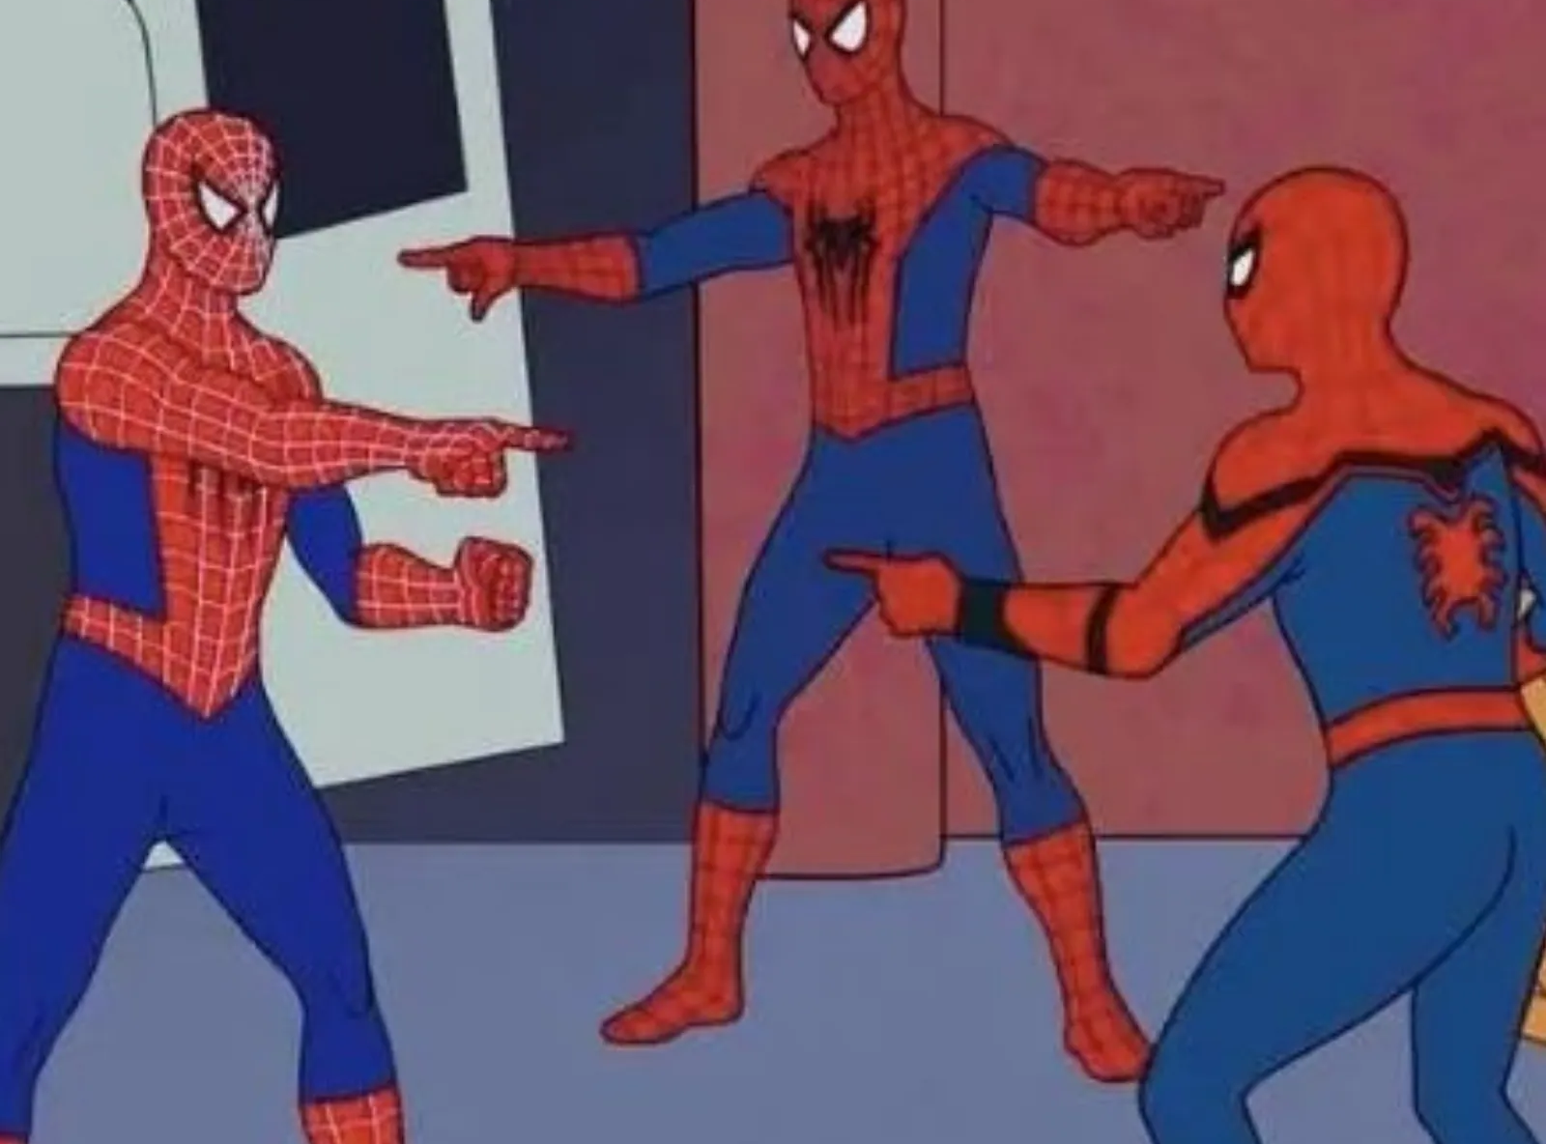
Anchor
Title
Body

Slide 3



Our Best Results
Top Secrets:
Short Queries : focus on title index
Return 100 docs
SUS???
Return only 5

Slide 4
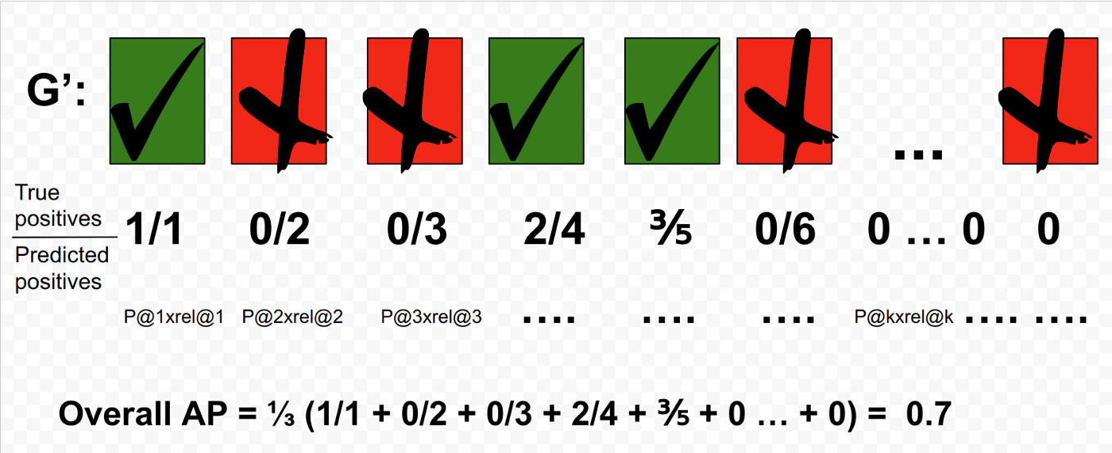

Map@40

Slide 5

Good luck on your exams

